Slide 1
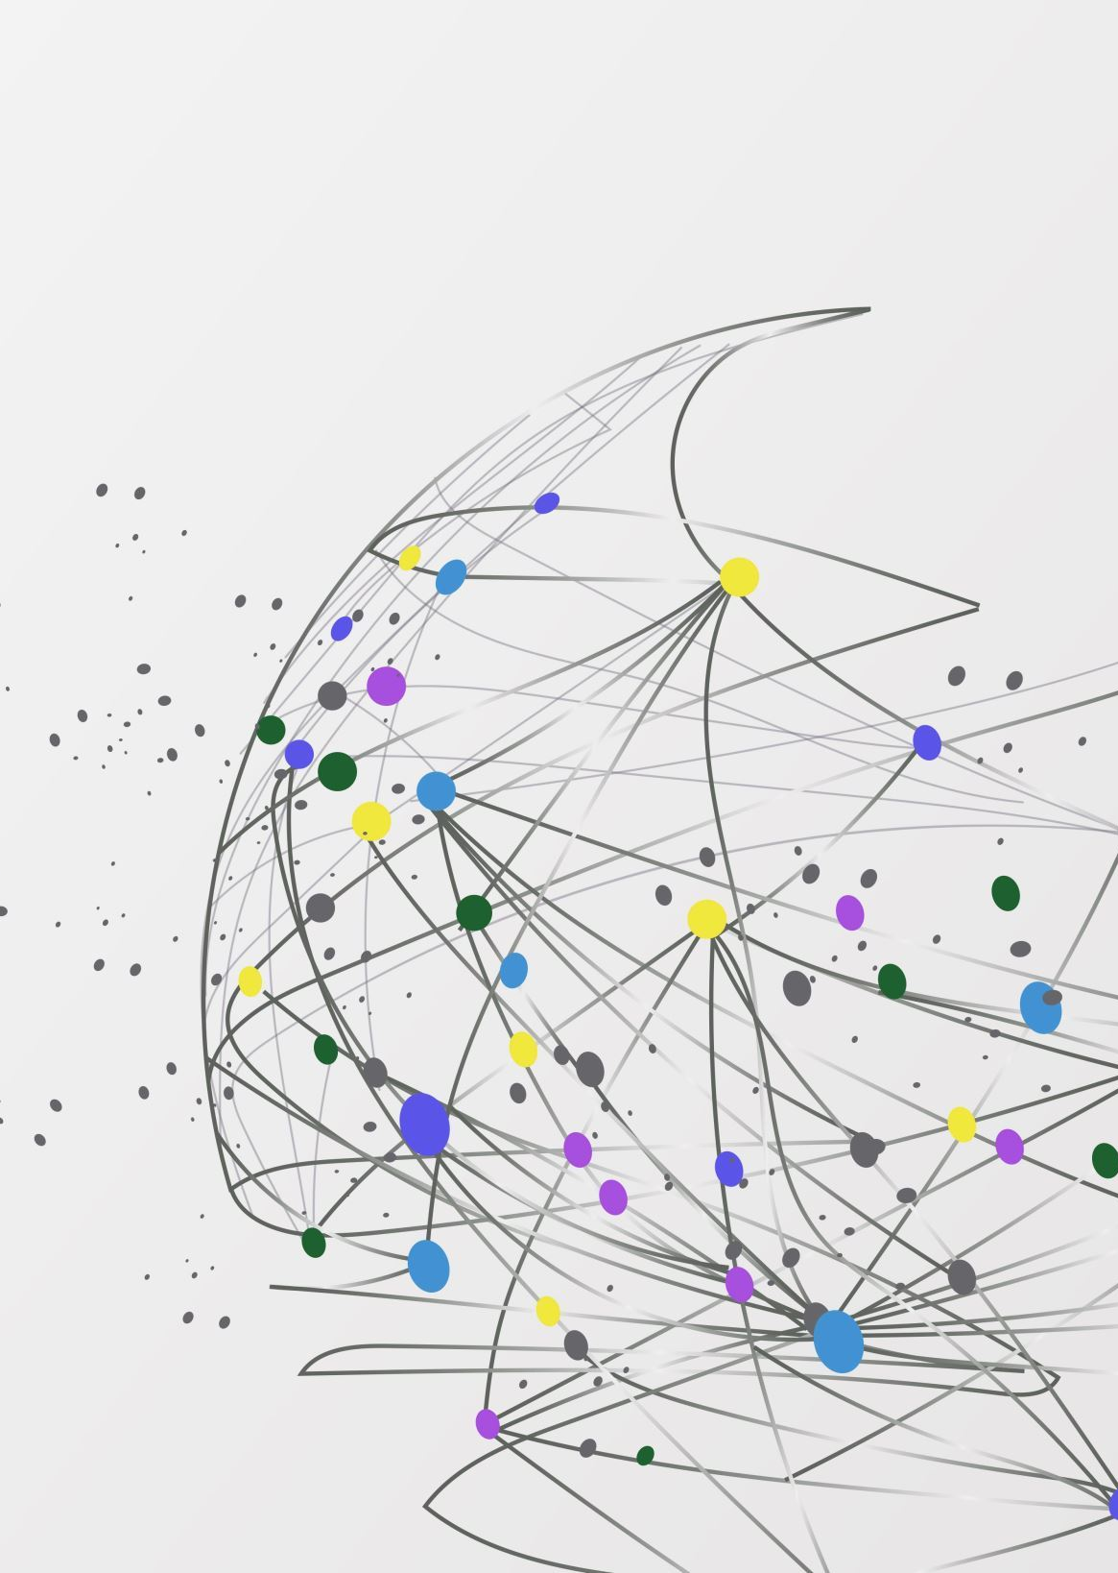
Seedling: A Personality-Guided AI Prototype
MacKenzie Miller IT460 Capstone

Slide 2
The Problem: Shallow AI Interactions
Most AI systems today lack personal context
ChatGPT & others respond well, but don't remember you
No emotional continuity or value-based identity

Slide 3
Seedling: A Framework for Simulated Identity
Emotion & trait-based processing
Ethical intent filter
Memory logging + influence
Fully modular and extensible

Slide 4
Planning the Framework
EmotionAnalyzer → TraitEngine
MemoryManager (bi-directional)
IntentGenerator → EthicsFilter → Output
All modules connected to a simple console I/O

Slide 5
Tech Stack
Python 3.12 – Core logic
Simple file I/O for memory
No LLMs – Intentionally bounded
Optional future: React, Tailwind, SQL Server

Slide 6
Limitations Right Now
No creative text generation
No dynamic or evolving personality
No long-term memory influence on behavior
No genuine emotional awareness
No LLM or neural architecture

Slide 7
What Went Well
Modular architecture for future add-ons
Real-time emotional tagging works
Data is persistently stored and labeled
Ethical filtering simulates boundaries
App runs reliably in terminal

Slide 8
Future Goals
Short-Term Goals:
Real response variety
Dynamic trait shifts over time
Memory influence on output
UI with React (instead of command line)
Long-Term (Seedling "X"):
Persistent evolving personality
Reflective journaling / self-schema
Voice interaction and affective avatars

Slide 9
Final Reflection
Every Personality Has to Start Somewhere

Slide 10
Live Demo

